Slide 1
An Overview
Database Systems
CHAPTER 2
Introduction to Data Model, Evaluation , Types of Data Models
Notes:
Database Systems (Spring 2011) - Naveed Anwer Butt @UOG

Slide 2
Session Objectives
A classification of data models
Concept and Evaluation Of Database Model
Types of Data Models
Relational Model
Components of Relational Model
Characteristics of Relational Database Model
Difference between a DBMS and RDBMS

Slide 3

DATA MODEL
A data model is a “description” of both a container for
data and a methodology for storing and retrieving data
from container.
“you can think of a data model as the infrastructure of the
data organizations, in other words, the way data is
presented to the user.”
Data model is…..
Not a thing
You cannot touch it
Data model are abstractions, mathematical algorithms & Concepts.
You can not touch a data model.
Notes:
4

Slide 4
Database Systems Models
Data base management systems follow particular
models (known as database models) to store and manipulate
data. A data base model is characterized by:
1. The way it stores data : STRUCTURE
2. The way data in the
structure are manipulated: OPERATIONS

Slide 5
Choosing Data Model
  There are three different styles of database management systems, each characterized by the way data are defined and structured, called database model.
  A particular database management system supports one of the four different architecture.

Slide 6
MAJOR DATABASE MODELS:
HIERARCHICAL MODEL
NETWORK MODEL
RELATIONAL MODEL
OBJECT ORIENTED MODEL
Notes:
5

Slide 7

Evolution of Database Model
Limitations
Searching for records
Data Redundancy
Data Inconsistency
Table
Table
Table
Indexed file
FLAT FILE
Index
Advantages
Overcame limitations
Compact
Easy to use
Accurate
Data in books and registers
Manual databases

Slide 8
Hierarchical Database Model
Definition:
“A data model in which records are arranged in a top-down structure that resembles a tree.”
Top file is called root
Bottom files are called leaves
Intermediate files have one parent
Note:
The terms parent and child are often used in describing a hierarchical model

Slide 9
Evolution of DB Systems
Flat files - 1960s - 1980s
Hierarchical – 1970s - 1990s
Network – 1970s - 1990s
Relational – 1980s - present
Object-oriented – 1990s - present
Object-relational – 1990s - present
Data warehousing – 1980s - present
Web-enabled – 1990s - present

Slide 10
Database models
2000s
1990s
1980s
1970s
1960s
?
Object oriented
Hierarchical
Relational
Client Oriented
Traditional files
Object-relational
Network

Slide 11
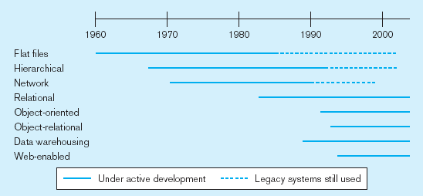
Evolution of DB Systems

Slide 12
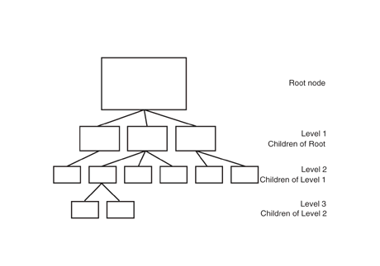
Hierarchical Database Model

Slide 13
DEPARTMENT
EMPLOYEE
PROJECT
SKILL
DEPENDENT
EQUIPMENT
Hierarchical Database Model

Slide 14
Models and Schemas
Model
  A structure that demonstrates all the required features of the parts of the real world which is of interest to the users of the information in the model.
  Representation and reflection of the real world (Universe of Discourse)
Data Model
  A set of concepts that can be used to describe the structure of a database: the data types, relationships, constraints, semantics and operational behaviour.
  It is a tool for data abstraction
A model is described by the schema which is held in the data dictionary.
Student(studno,name,address)
Course(courseno,lecturer)
Student(123,Bloggs,Woolton)
(321,Jones,Owens)
Schema
Instance

Slide 15
Characteristics of Hierarchical DBMS
Records have a parent-child relationship
Child may have only on parent but a parent have multiple children.
The user must know how the tree is structured in order to find anything!
Parents and children are tied together by links are called “pointers”(physical address inside the file system)
High performance
Simple structure

Slide 16
Drawbacks:
Tedious to reorganize
Real life requirements are more complex
Example:
Hierarchical database technology is used for high-volume transaction processing and MIS applications.
IBM’s information Management System(IMS) (1968) on IBM mainframes.

Slide 17
Network Database Model
A data model in which each child may have multiple parents.
The network model is very similar to the hierarchical model actually
The hierarchical model is a subset of the network model.

Slide 18
DEPARTMENT
EMPLOYEE
PROJECT
DEPENDENT
EQUIPMENT
Network Database Model

Slide 19
Characteristics of Network DBMS
Network model solves the problem of data redundancy by representing relationships in terms of sets rather than hierarchy.
Computer programmers rather than users used implementations of network model.
Relationships are pre-defined
Navigation done by the programmer

Slide 20
File Based Systems
File based Systems
Data is stored in files
Each file has special format
Programs that use these files depend upon knowledge about that format
Problems
No standers
Data duplication
Data dependence
No provision for security,recovery, concurrency etc….

Slide 21
Relational Systems
Problems with early databases
Navigating the records requires complex programs.
There is minimal data independency
No theoretical foundations
Then in 1970’s E.F Codd wrote a “relational Model of data for large shared databanks” and introduce the relational model.

Slide 22
The Relational database:Definitions
“A DBMS that manages data as collection of tables in which all data relationships are represented by common values in related tables.”
“A DBMS that follows all the twelve rules of CODD is called RDBMS”

Slide 23
Relational Database definition
All information must be represented explicitly in one and only one way: as values in tables and each & every datum in the database must be accessible by specifying a table name, a column name, and a primary key.

Slide 24
Relational Database: Definitions
Relational database: a set of relations.
Relation: made up of 2 parts:
– Schema : specifies name of relation, plus
name and type of each column.
• E.g. Students(sid: string, name: string, login: string, age: integer, gpa: real)
– Instance : a table, with rows and columns.
•#rows = cardinality
•#fields = degree / arity
• Can think of a relation as a set of rows or tuples.
– i.e., all rows are distinct

Slide 25
Relational Model
The Relational Model developed by Dr. E. F. Codd at IBM in the late 1960s
The model built on mathematical concepts, which expounded in the famous work called "A Relational Model of Data for Large Shared Databanks".
At the core of the relational model is the concept of a table (also called a relation) in which all data is stored.
Records (horizontal rows also known as tuples) & Fields (vertical columns also known as attributes).
It is important to note that how or where the tables of data are stored makes no difference.
Table can be identified by a unique name.
This is quite a bit different from the Hierarchical & Network models in which the user had to have an understanding of how the data was structured within the database in order to retrieve, insert, update, or delete records from the database.

Slide 26
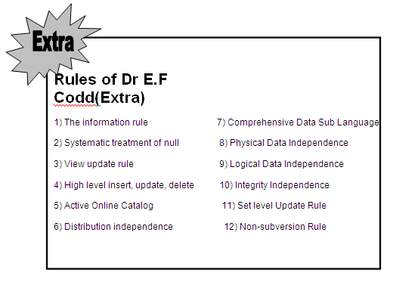

Slide 27
Advantages:
The data access methodology in relational model is quite different from and better than the earlier database models .
Another benefit of the relational system is that it provides extremely useful tools for database administration.
Meta-data (data about the table and field names which form the database structure, access rights to the database, integrity and data validation rules etc).
Thus everything within the relational model can be stored in tables. This means that many relational systems can use operations recursively in order to provide information about the database.

Slide 28


TABLE (Relation)
Domain
Domain
Primary Key
Supplier
SCode | SName | Quantity | City
S1 | Kamran | 20 | Lahore
S2 | Zafar | 10 | Islamabad
S3 | Azmat | 40 | Karachi
S4 | Abdul | 34 | Lahore
S5 | Nasir | 25 | Islamabad
Tuples
Cardinality
Attributes
Degree

Slide 29
Attribute (field):
Member of a relation type (set / table).
Attribute Name:
All attribute names must be unique within a table / relation.
Attribute Domain:
A set of all possible values that can be attain by an attribute.
Attribute Value Set:
Values currently contained in an attribute.
Relation / Table Degree:
Number of attributes in a relation / table.
Tuples:
Rows in a table / relation.
Cardinality:
Number of tuples in a relation / table.

Slide 30
Ex: Instance of Students Relation
Student(studno,name,address)
Course(courseno,lecturer)
Student(123,Bloggs,Woolton)
(321,Jones,Owens)
Schema
Instance
sid | Name | Login | age | GPA
53666 | Jones | Jones@ca | 18 | 3.4
53444 | smith | Smith@ecs | 18 | 3.2
53777 | Blake | Blake@aa | 19 | 3.8
• Cardinality = 3, arity = 5 , all rows distinct
Do all values in each column of a relation instance have to be distinct?

Slide 31
Database Schema
The description of the database is called database schema. A database schema is describe during database design and not expected to change frequently.
Schema Diagram
Displayed schema is called schema diagram. Each object in schema is called a schema construct.

Slide 32
Database instance (occurrence or state)
The data in a database at a particular moment of time.
Intension & Extension
The schema is sometimes called the intension and a database instance is called an extension of the schema.

Slide 33
Relational Database Concepts
Table
Field
CD_ID | Title | Artist | Genre
1 | The Wall | Pink Floyd | Rock
2 | Blue Train | John Coltrane | Jazz
3 | Requiem | W.A. Mozart | Classical
Record

Slide 34
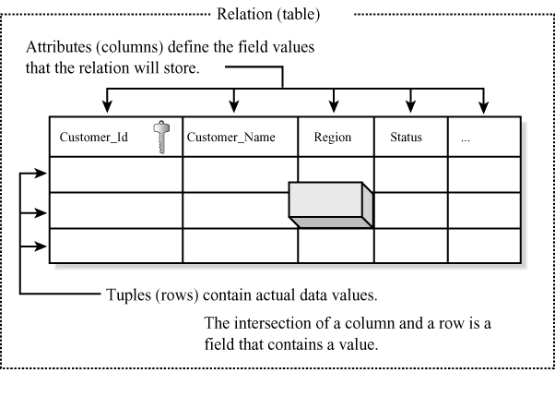
Basic component of a Relation

Slide 35
Tuple:
The actual data values for the attributes of a relation are stored in tuples, or rows, of the table.
It is not necessary for a relation to have rows in order to be a relation; even if no data exists for the relation
The relation remains defined with its set of attributes
Attribute:
The term attribute refers to characteristics.This simply means that what the column contains will be defined by the attribute of the column

Slide 36
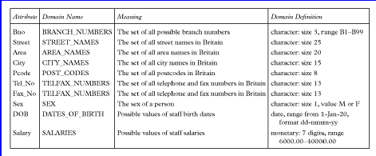
Examples of Attribute Domains

Slide 37
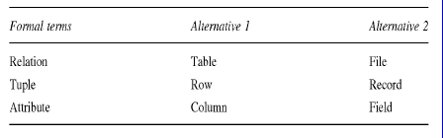
Alternative Terminology for Relational Model

Slide 38
Characteristics of Relational Database Model
Built in data integrity
Data consistency and accuracy
Easy data retrieval and data sharing
How and where the tables of data stored make no difference
You can access child table with out accessing parent table.
Non-navigational in nature
Find the data on the basis of the data values themselves.
One point data administration
Controlling redundancy
Data abstraction

Slide 39
Continue……..
Provide security
Data entry , update and deletion will be efficient.
Changes to the of the database is somewhat self-documenting.
Support multiple users

Slide 40
Difference between a DBMS and RDBMS
DBMS | RDBMS
The concepts of relationships is missing in a DBMS. If it exits it is very less. | It is based on the concept Of relationships
Speed of operation is very slow | Speed of operation is very Fast
Hardware and Software requirements are minimum | Hardware and Software requirements are High
Platform used is normally DOS | Platform used can be any DOS, UNIX,VAX,VMS, etc
Uses concept of a file | Uses concept of table
DBMS normally use 3GL | RDBMS normally use a 4GL
Examples are dBase, FOXBASE, etc | Examples are ORACLE, INGRESS, SQL Server 2000 etc

Slide 41
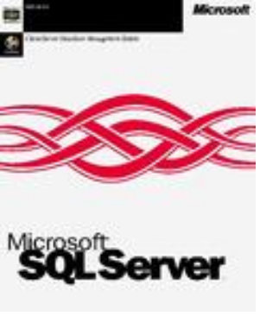
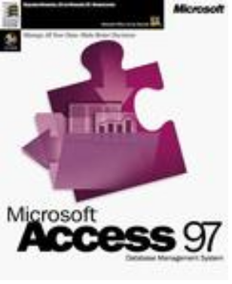







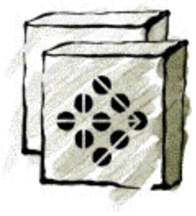
Popular DBMS In The Market
Sybase SQL Anywhere
Informix Dynamic Server
Borland Interbase

Slide 42
Popular RDBMS that support SQL
• Oracle
• Sybase
• Microsoft SQL Server
• Informix
• Ingress
• DB2

Slide 43
Typical Components
End users
Software
interact
Application Programs
Application Programmers
develop
“What” to get
DBMS
Database Administrators
maintain
Data
“How” to get
Database
Designers
Database
design
Users

Slide 44
RDMS Components
File Manager – Manage the allocation of space and the way the data organized and represented in storage
Database Manager – acts an interface between the users and the data in the database.
Query Processor – Interprets the queries issued by the database users.
Data Dictionary – storehouse of the data
DML Pre compiler –interprets insert,delete and modify statements
DDL Complier – interprets create statements

Slide 45
Country | Capital
Italy | Rome
India | New Delhi
China | Beijing
France | Tokyo
Japan | Paris
Country | Currency
Italy | Lira
India | Rupee
China | Quan
France | Yen
Japan | Francs

Slide 46
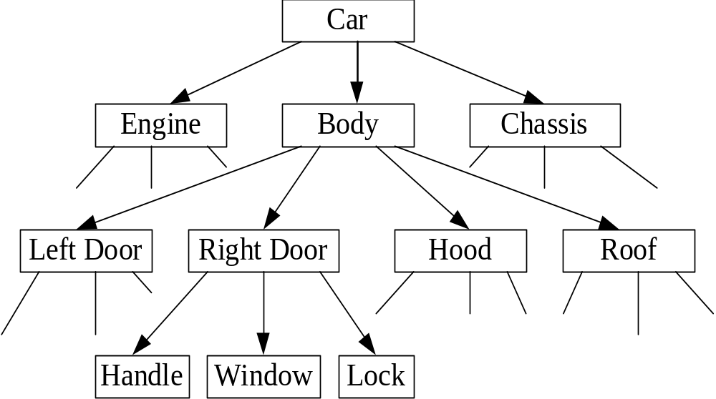

Slide 47
PRINCIPLES OF RELATIONAL MODEL
Data about various entities and their relationships
are stored in a series of logical tables (also known as
relations).
A relation is a two-dimensional table with certain imposed
restrictions:
1. Each Row is unique: No duplicate row
2. Entries in any column have the same domain.
3. Each column has a unique name
4. Order of the columns or rows is irrelevant
5. Each entry in the table is single valued:
No group item, repeating group, or array is allowed.
Note: A domain is the set of all possible values an attribute may assume.
Example: Domain of Major= (Acct, Mktg, Mgmt, ISOM, Fina)
Notes:
6

